Slide 1

Capital Market Presentation
October 2020

Slide 2
Disclaimer
This presentation includes general information regarding DIC and/or companies held by it (together the “DIC Group”).
The securities of DIC Group, DIC and the securities of other entities of the IDBD Group and the DIC Group are traded on the Tel Aviv Stock Exchange (“TASE”). Accordingly, IDBD, DIC and such entities submit their reports (including financial reports and immediate reports) to the TASE, on an on-going basis. This presentation and the information provided herein should be read together with the relevant companies’ reports to the TASE.
For further information regarding the financial, legal and other affairs of IDBD and DIC, including current legal proceedings and prospective cash flow reports, please refer to IDBD and DIC’s 2017 Annual Report, along with the 2018 quarterly reports and the respective immediate reports submitted to the TASE.
This presentation and the information provided here within, may include confidential information with respect to IDBD, DIC and/or the IDBD Group and the DIC Group. Therefore, any information provided herein may lie under the framework of confidentiality undertakings and should be read and/or used accordingly.
The confidential information herein may be used solely for the purpose of considering and providing an offer for D&O insurance coverage, and not for any other purpose. The confidential information is to be maintained in strictest confidence, and should not be distributed, published or disclosed, in whole or in part, directly or indirectly, to any third party. Without derogating from the generality of the aforesaid, the confidential information may include “material non-public information” (“Inside Information”) as such term is referred to in the Israeli Securities Law, 1968, as enacted from time to time (the “Securities Law"). You are required to refrain from any action that may constitute a violation of the Securities Law, and particularly with respect to “material non-public information".
It is further noted that this presentation may include projections, valuations, perspectives and certain other forward-looking statements and information. Such forward-looking information is based on IDBD Group’s and DIC’s Group’s current analysis and valuations, according to the information known to them. The actual results may be different, even significantly, from such projections, valuations, perspectives and other forward looking statements.
Market prices as of 15/10/2020, book value as of 30/06/2020 unless otherwise stated

Slide 3
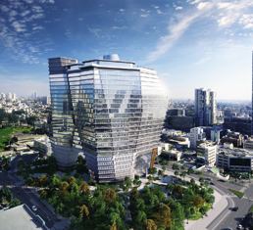


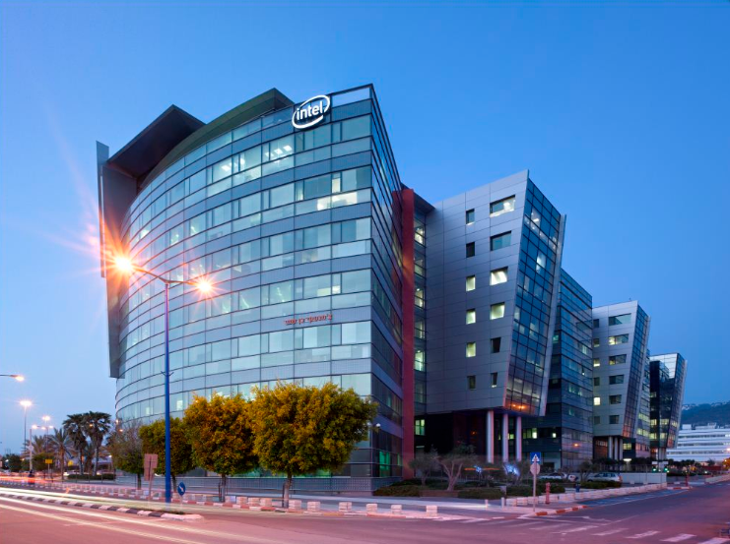
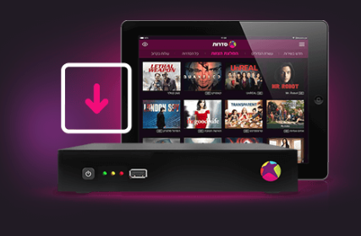

DIC In numbers (market prices as of 15/10/20 book value as of 30/06/20)
Total assets: NIS 20 billion.
DIC’s liquidity: NIS 1.9 billion
Group’s liquidity: NIS 6.0 billion*
Total employees: ~ 4,000
Total Equity: NIS 1,552 million
Market value of tradable holdings: NIS 2,798 million
LTV: 58%
Market cap NIS 1,083 million
*Including DIC (adjusted to Shufersal realization), PBC, Mehadrin, Cellcom, Elron all as of 30/06/2020

Slide 4
DIC Group
Agriculture
Mehadrin
(44.5%)
Telecommunication
Cellcom
(46.1%)
Diversified portfolio*
Real Estate
PBC
(74.1%)
Cyber security and medical devices
Elron
(61.1%)
Finance
Epsilon
(68.8%)
*based on market cap

Slide 5

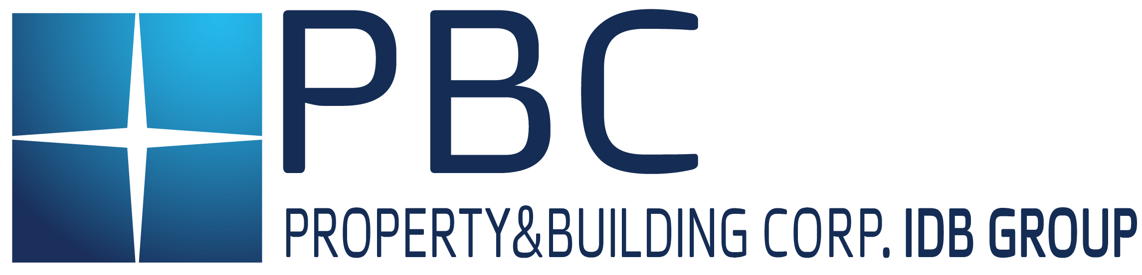






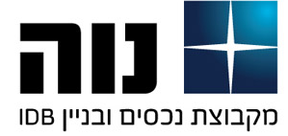
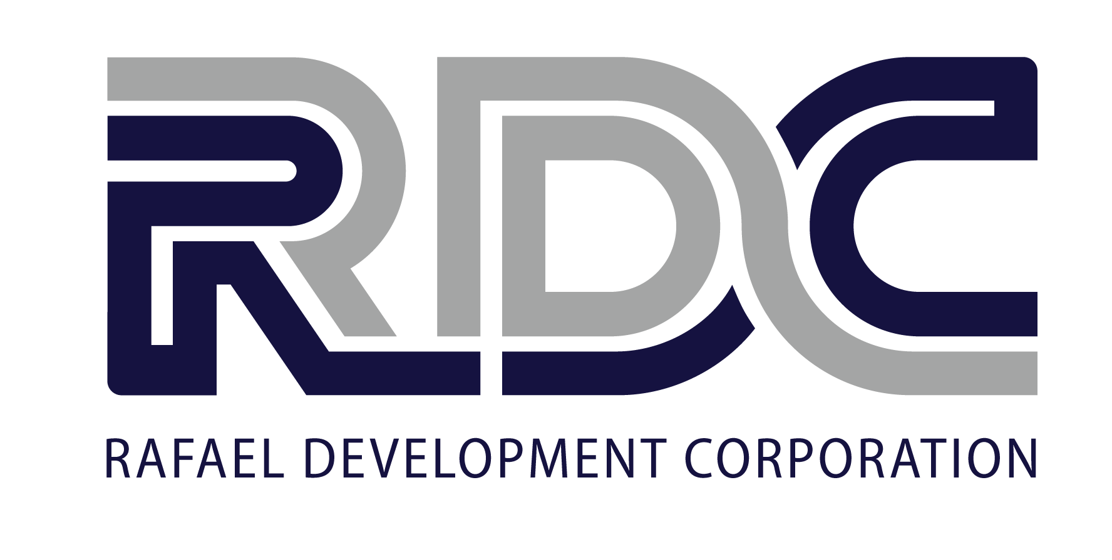
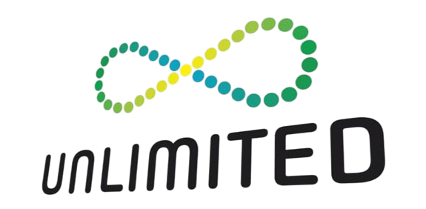

Holding Structure
74.1%
44.5%
61.1%
68.8%
46.1%
Others
100%
74.2%
29.9%
100%
100%
50.1%
35%
100%
HSBC Tower
IDBG

Slide 6
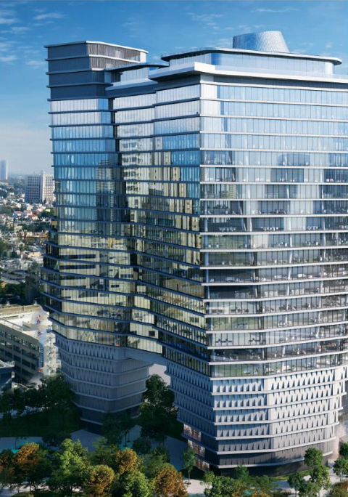
Property and Building Corp – PBC (74.1%)
A Leading Real Estate company operates in income-producing real estate in Israel and abroad , as well as residential development and urban renewal
  Gav Yam (29.9%): largest shareholder
  Top tier real estate company in Israel
  GLA: more than 1 million sqm, book value NIS 8 billion
  Occupancy: 98%
  Top Tier tenant: Amazon, Apple, Google, Oracle, WIX, Intel, Elbit, Mellanox , etc.
Israel operations:
  Income-producing: office and retail – 170 k sqm, occupancy 92%
  Residential: more than 2,600 units under development and initiation
International operations:
  HSBC tower, Manhattan: 80k sqm
  Tivoli village , Las Vegas: mixed use project , retail office
ILS 6.3 B
Investment in Real Estate
Liquidity: NIS 2.2 B
Market Cap NIS 1.7 B

Slide 7
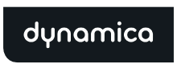
Cellcom (46.1%)
Cellcom Israel Ltd. (TASE: CEL, NYSE: CEL) , is a leading Israeli communications group, providing a wide range of communications services
Cellcom Israel is the largest Israeli cellular provider, providing its approximately 3.6 million cellular subscribers
Provides a broad range of services including: cellular telephony data and content services, OTT TV services, internet infrastructure and connectivity services, international calling services and landline telephone services
Holds and operates an independent transmission network
Fastest growing company in TV, Internet & fixed line services:
    ISP Service for 283k households
    TV service for 245k households
3,6 M
Subscribers
35%
Market Share
NIS 2.2 B Market Cap

Slide 8




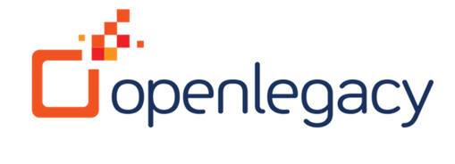

Elron (61.1%)
Founded in 1962, Elron (TASE: ELRN) is a leading Israeli investment company
Elron specializes in the field of medical devices and cyber and Currently invested in 25 Portfolio companies
Owns 51% of RDC - Rafael Development Corporation, the commercialization arm of Rafael Advanced Defense Systems
  In the last 10 years, Elron received USD 580 million from successful exits( including RDC)
  Elron’s current main investments:
$ 228 M
Investments
cash
$ 137 M
Market cap
$ 40 M

Slide 9

Mehadrin (44.5%)
Founded in 1952. Mehadrin is largest company in Israel specializing in the growing and maintenance of orchards and groves. Active in the entire value chain: growing, packaging, logistics and marketing globally
4 business segments:
  Agriculture: Holds and operates ~ 10 k acres among ~3k acres in leases
  Real estate: Logistics and storage
  Water: supply water from wells owned by the country
  Refrigeration: manages and operates ~31k sqm of refrigeration areas.
Total revenue: NIS 1.3 Billion
2 Revenues drivers: citrus (43%), Avocado (31%) of total revenues
Total Equity: NIS 561 million
Market cap: NIS 473 million
NIS 1.3 billion - Revenues
NIS 561 million - Equity
450 employees

Slide 10


Epsilon (68.8%)
Founded in 1988, Epsilon is an Israeli leading, professional and high-quality investment house Epsilon’s Areas of operation are : Portfolio management, Mutual funds management, Provident and hedge funds management, and investment banking
  Underwriting and issuing - Epsilon specializes in raising equity and debt and other securities in the Israeli capital market. Total issuances: NIS 77 B – 264 transactions among 117 as a leader
  Portfolio management - investment portfolios management for private clients and for public and private companies – total UAM NIS 3.3 billion
  Mutual funds management - Epsilon has varied funds under management, specializing in a variety of sectors. Total AUM NIS 1.7 billion
  Hedge Fund : NIS 0.15 billion
NIS 77 Billion - Issuances
NIS 3.3 billion portfolio management
28 Mutual Funds

Slide 11
Financials

Slide 12
Net Asset Value - NAV
NIS million | Share | Holding value (market as of 15/10/2020) | Holding value (book as of 30/06/2020)
Cellcom | 46.1% | 1,016 | 1,241*
PBC | 74.1% | 1,287 | 1,460**
Elron | 61.1% | 285 | 137***
Mehadrin | 44.5% | 211 | 285
Epsilon |  | 55 | 55
Others |  | 80 | 80
Total Assets |  | 2,933 | 3,258
Gross debt |  | (3,612) | (3,612)
Liquidity |  | 1,909 | 1,909
Net Debt |  | (1,703) | (1,703)
NAV**** |  | 1,230 | 1,555
LTV |  | 58% | 52%

Slide 13
Liquidity and Amortization Schedule
Liquidity: NIS 1,909 million as of 15/10/2020
390
755
724
694
664
634
342

Slide 14
Liabilities - Summary
 | Series 6 | Series 10
Face value (NIS) | 1,294,666,129 | 1,954,628,713
Par (cents) | 125.54 | 101.38
Pari (NIS million) | 1,625 | 1,982
Coupon | 4.95% | 4.80% (current 5.30%)
Linkage | CPI | NIS
Price | 126.31 | 102.46
YTM | 4.67% | 5.10%
Duration | 2.46 | 3.31
Spread | 4.90% | 4.89%
Amortization schedule (principal) | 2020-2025: 6 equal installments 31/12 | 2021-2026: 6 equal installments 30/12
Interest payment | Annual 31/12 | Semiannual 30/06’30/12
Default covenants | - | -
Interest step up | - | Credit Rating: For every notch below ilBBB :0.25% max. 1% NAV < 1.1 B and LTV > 75%: 0.25% LTV > 85% : 0.5% Equity/total assets solo < 12.5%: 0.25%
Early repayment | - | Highest of: Pari, Market, DCF (treasury + 1.5%)

Slide 15
THANK YOU

